Slide 1
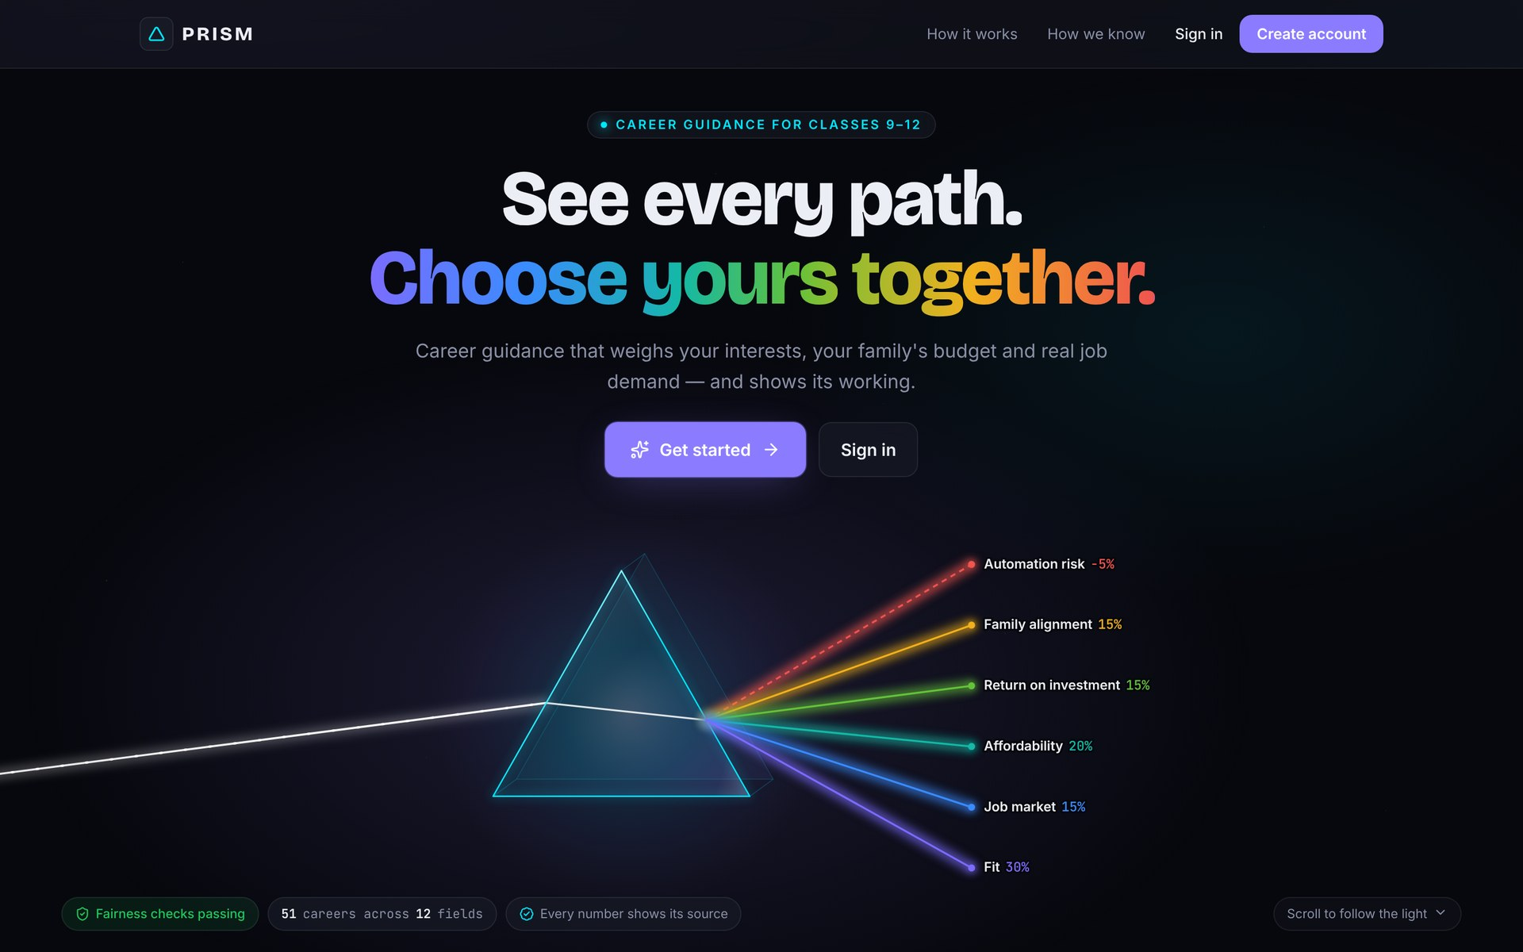
PRISM
DATAQUEST 3.0 · TEAM CODEALCHEMISTS
See every path.
Choose yours together.
Multi-Dimensional STEAM Career Guidance & Hyper-Local Innovation Platform
Dipanshu Barua · 26BAI1239
Raag Mangukiya · 26BAI1200
Aryan Verma · 26BAI1206
Aaryan Arora · 26BAI1431
Notes:
Good morning. We are team CodeAlchemists, and this is PRISM: career guidance that sees the whole student, their family and their home town. Like light through a prism, one decision splits into six visible parts. Everything you will see today is a working product, not a mock-up.

Slide 2



The brief: guidance that sees the whole student, and their home town
THE PROBLEM STATEMENT
Multi-dimensional
STEAM careers
Hyper-local innovation
Look at interests, aptitude, values, money and family, not just marks.
Science, technology, engineering, arts and maths, explained with real costs and jobs.
Connect students to real problems in their own district.
PRISM answers all three in one working platform for students, parents, counsellors and schools.
PRISM · DataQuest 3.0 · 02
Notes:
The problem statement asks for three things: guidance across many dimensions of a student, a focus on STEAM careers, and a link to hyper-local innovation, meaning real problems in the student's own district. The next slide shows why the guidance students get today falls short of this.

Slide 3
Most Class 10–12 students choose a career from three inputs
WHY THIS MATTERS
Marks
What relatives say
The neighbour's child
A single number decides the stream.
Advice from a different job market.
One example, copied.
Aptitude tests stop at "you suit engineering". They ignore the questions families actually argue about:
"Can we afford it, and will the loan be repaid?"
"Will there be jobs in four years, and near home?"
"Why does my child want design when we want medicine?"
PRISM · DataQuest 3.0 · 03
Notes:
Today most students choose from three inputs: their marks, what relatives say, and what the neighbour's child did. Aptitude tests help a little, but they stop at "you suit engineering". The real decision happens at the dinner table, around money, jobs near home, and disagreement between parent and child. PRISM is built around those three questions.

Slide 4




Four people, one decision
WHO IT IS FOR
Student
Parent
Counsellor
Admin
Discovers strengths and sees why each career fits.
Enters the budget and hopes privately, and sees where they and their child differ.
Supervises hundreds of students and sees who needs a conversation.
Monitors fairness, data freshness and outcomes.
PRISM · DataQuest 3.0 · 04
Notes:
PRISM serves four people around one decision. The student discovers their strengths. The parent enters the budget and their hopes privately. A school usually has one counsellor for a very large number of students, so PRISM does the counselling at scale and the counsellor's dashboard shows who needs a human conversation. The admin keeps an eye on fairness, data freshness and outcomes.

Slide 5
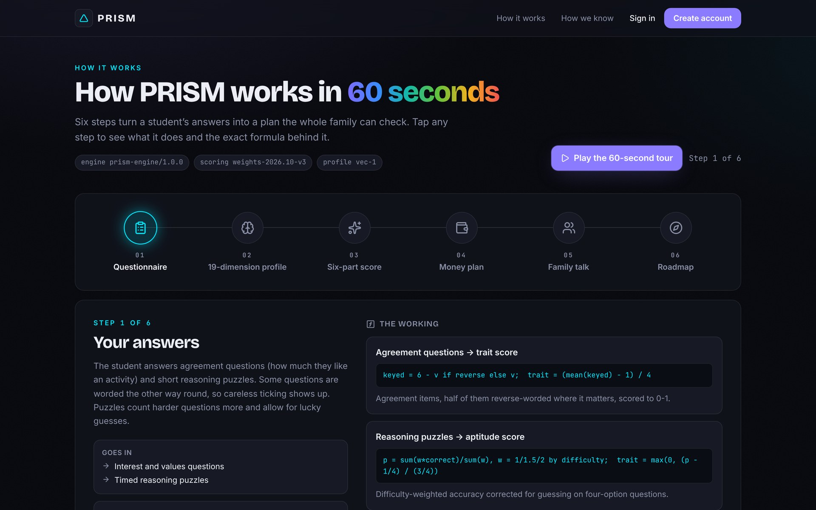
From a 25-minute questionnaire to a family plan
WHAT PRISM DOES, END TO END
01
02
03
04
05
06
Questionnaire
19-dimension profile
Six-part score
Money plan
Family meeting
5-year roadmap
PRISM · DataQuest 3.0 · 05
Notes:
Here is the whole journey in six steps. The student answers a questionnaire of about 25 minutes. That becomes a 19-dimension profile. Every career gets a six-part score. The family sees a money plan, has a guided family meeting, and leaves with a five-year roadmap. The app explains each step itself on this "How it works" page.

Slide 6
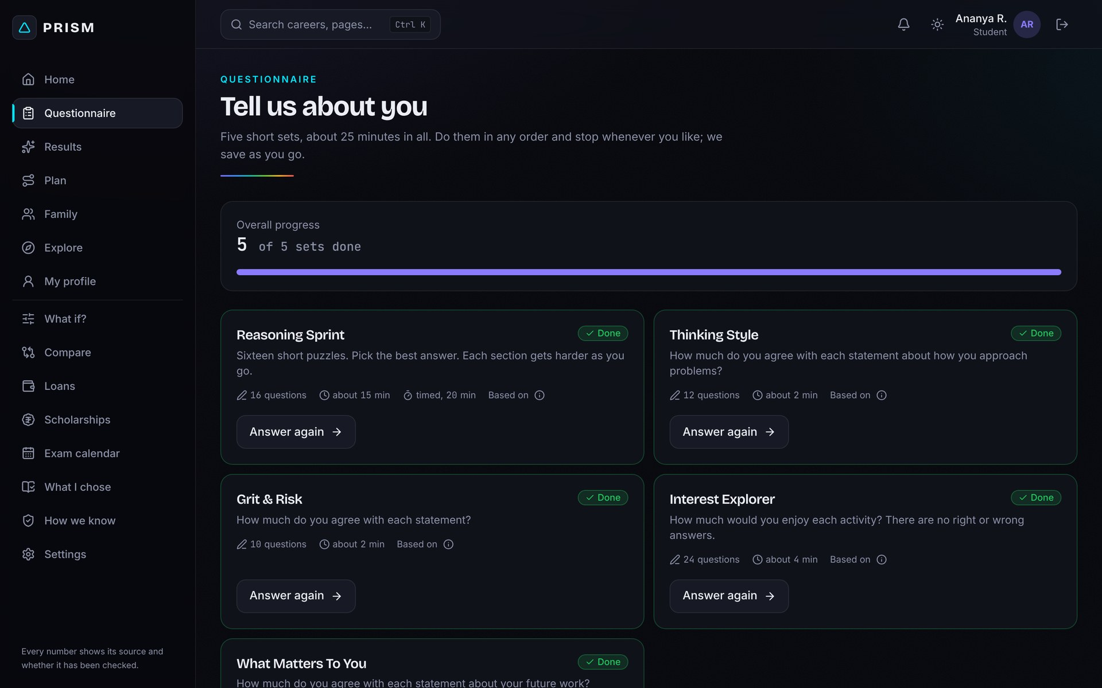
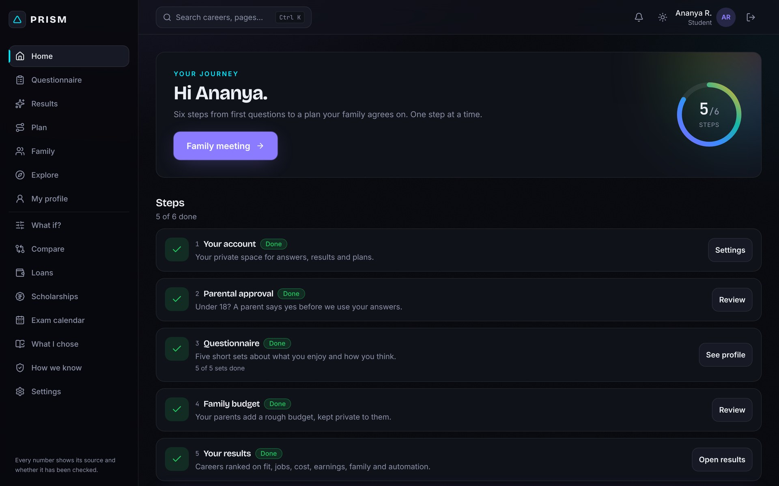
74 original questions measure 19 dimensions, not just marks
STEP 1 · UNDERSTANDING THE STUDENT
What it measures
Interests (RIASEC), four aptitudes, thinking style, work values, grit and risk tolerance.
Quality checks built in
Rushed or contradictory answers are caught and flagged.
Fits a school day
Take it in two sittings; progress is saved, and the Home page shows the next step.
PRISM · DataQuest 3.0 · 06
Notes:
The questionnaire has 74 original questions that measure 19 dimensions: interests using the RIASEC model, four aptitudes, thinking style, values, grit and risk tolerance. It catches rushed or contradictory answers, and it can be taken in two sittings. The Home page, shown small, walks the student through each step of the journey.

Slide 7
Every career gets one score, split into six visible parts
STEP 2 · THE CORE IDEA
Score = 0.30 Fit + 0.15 Market + 0.20 Affordability + 0.15 ROI + 0.15 Family − 0.05 Automation risk
Fit · 30%
Job market · 15%
Affordability · 20%
The 19-dimension profile matched to each career.
Salaries and live job postings by region.
Cost after scholarships against family income.
Return on investment · 15%
Family alignment · 15%
Automation risk · −5%
10-year earnings against starting work after Class 12.
How far parent and child agree, across six areas.
Exposure to automation; the only part that subtracts.
PRISM · DataQuest 3.0 · 07
Notes:
This is the heart of PRISM. Every career gets one score, and that score splits into six weighted parts: fit, job market, affordability, return on investment, family alignment, and automation risk, which is the only part that subtracts. That is where the name comes from: like white light through a prism, one number splits into six visible colours. The same colours are used everywhere in the app.

Slide 8
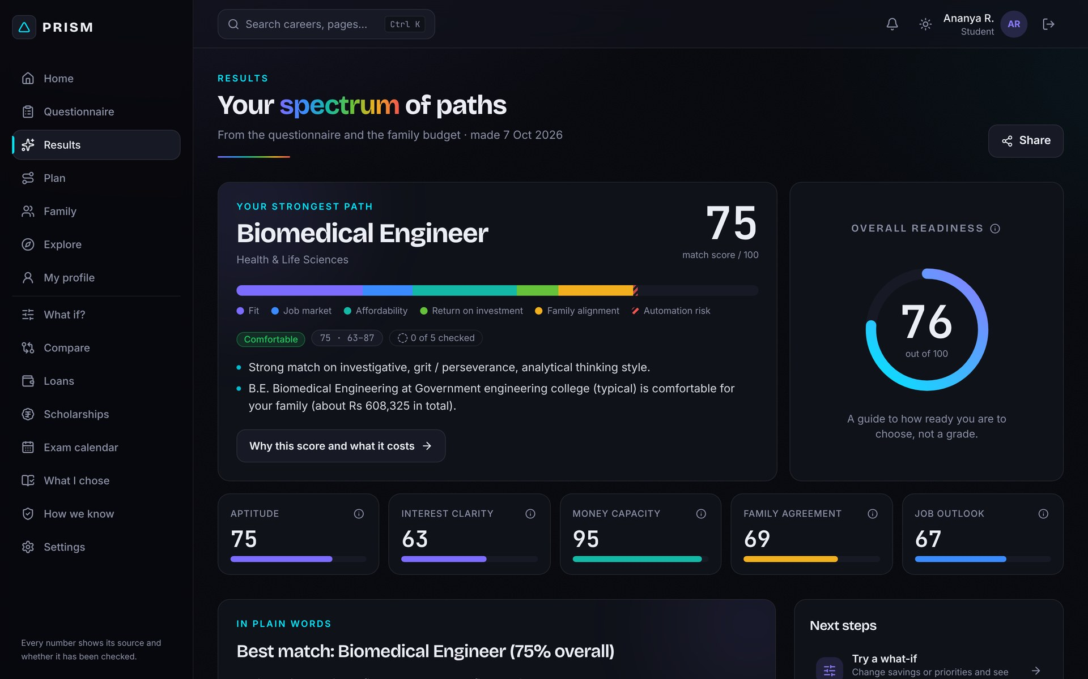
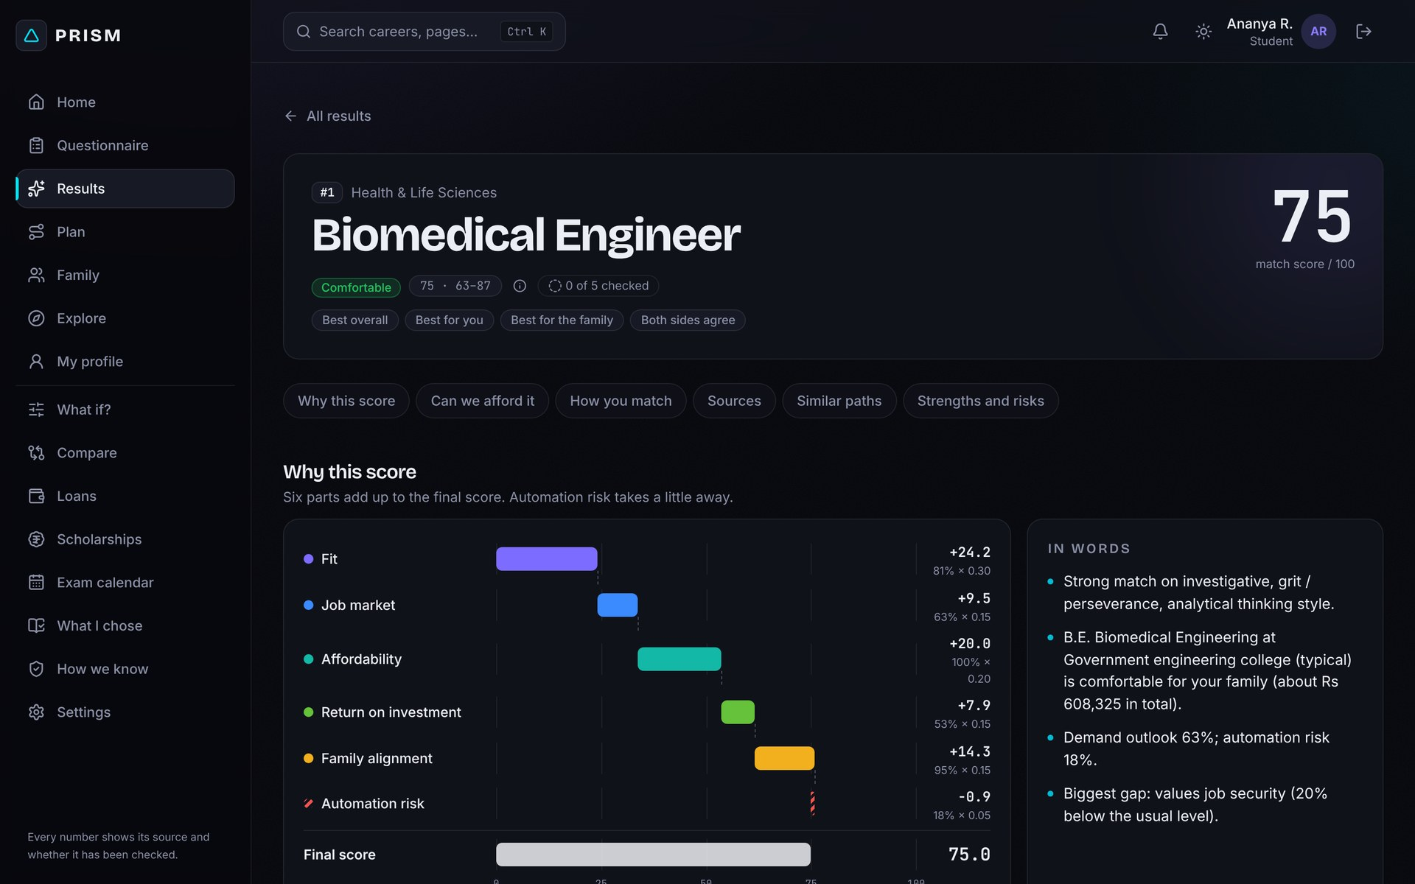
Click any career to see exactly why it scored what it did
STEP 3 · NOTHING IS A BLACK BOX
Points, part by part
Each of the six parts shows its contribution to the final score.
A range, not false precision
"75 · likely 63–87": the range widens when inputs are estimates.
Stability tested
Each rank is re-checked across 64 what-if scenarios.
PRISM · DataQuest 3.0 · 08
Notes:
This is a real result for our demo student Ananya. Her top path is Biomedical Engineer at 75, and the bar shows how each of the six parts contributed. One click opens "Why this score", inset, with the points for every part. We show a likely range instead of a falsely precise number, and we test how stable each rank is across 64 what-if scenarios.

Slide 9
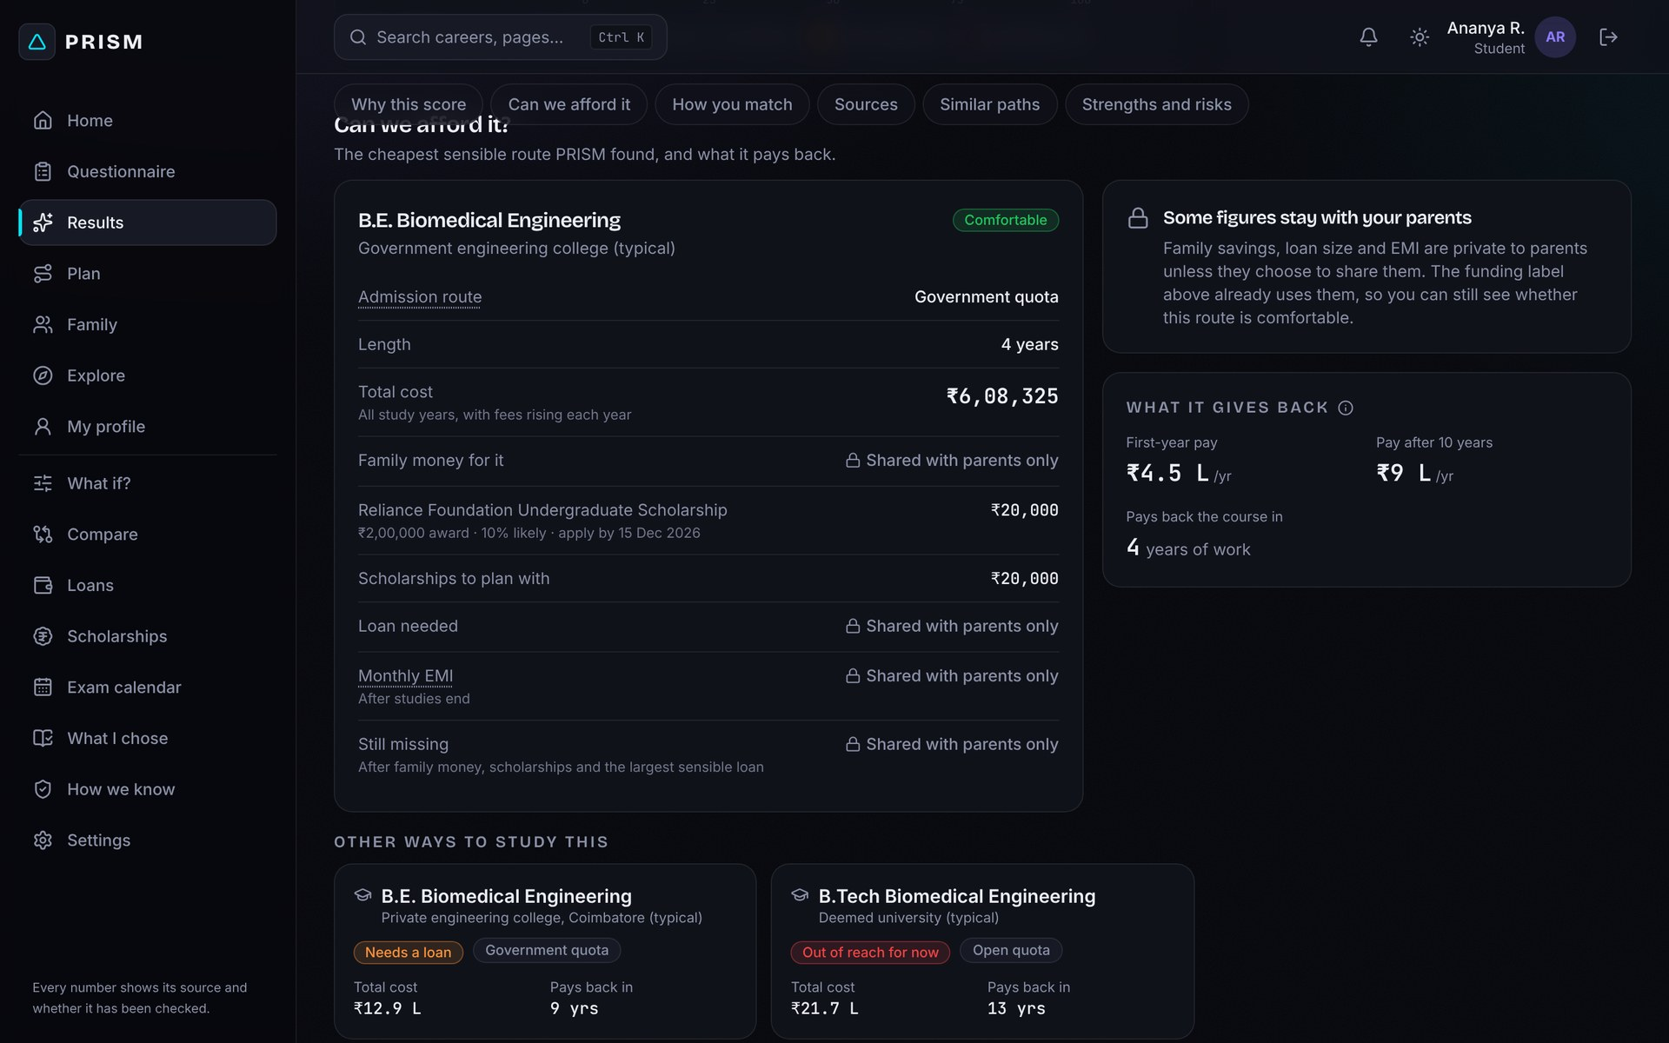
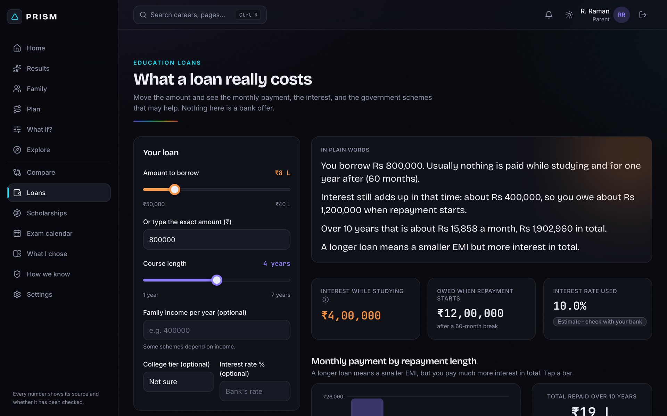
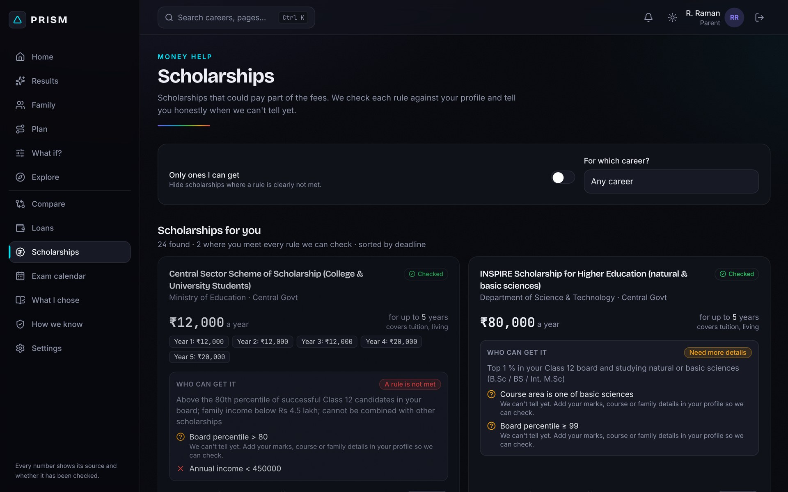
The real cost, scholarships and loan EMI, before the family commits
STEP 4 · MONEY MADE CONCRETE
Fees per quota
Government and management seats, costed separately.
Scholarships that apply
42 schemes checked against the student's own profile.
Loans in plain words
The EMI against monthly income, with a warning when it strains the family.
PRISM · DataQuest 3.0 · 09
Notes:
Money is usually where the conversation breaks down, so PRISM makes it concrete. Every course is costed per admission quota. We check 42 scholarship schemes against the student's profile and list the ones that actually apply, with deadlines. And the loan explainer shows the EMI against the family's monthly income, in plain words, before anyone signs anything.

Slide 10
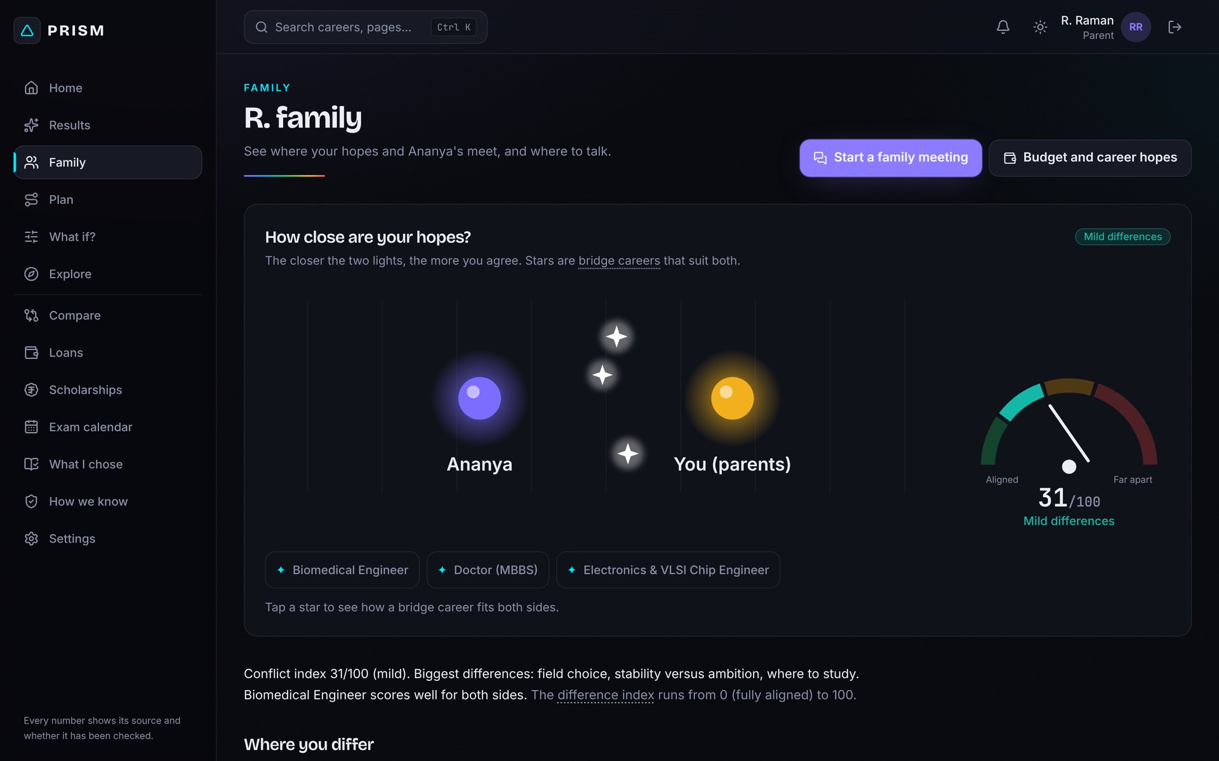
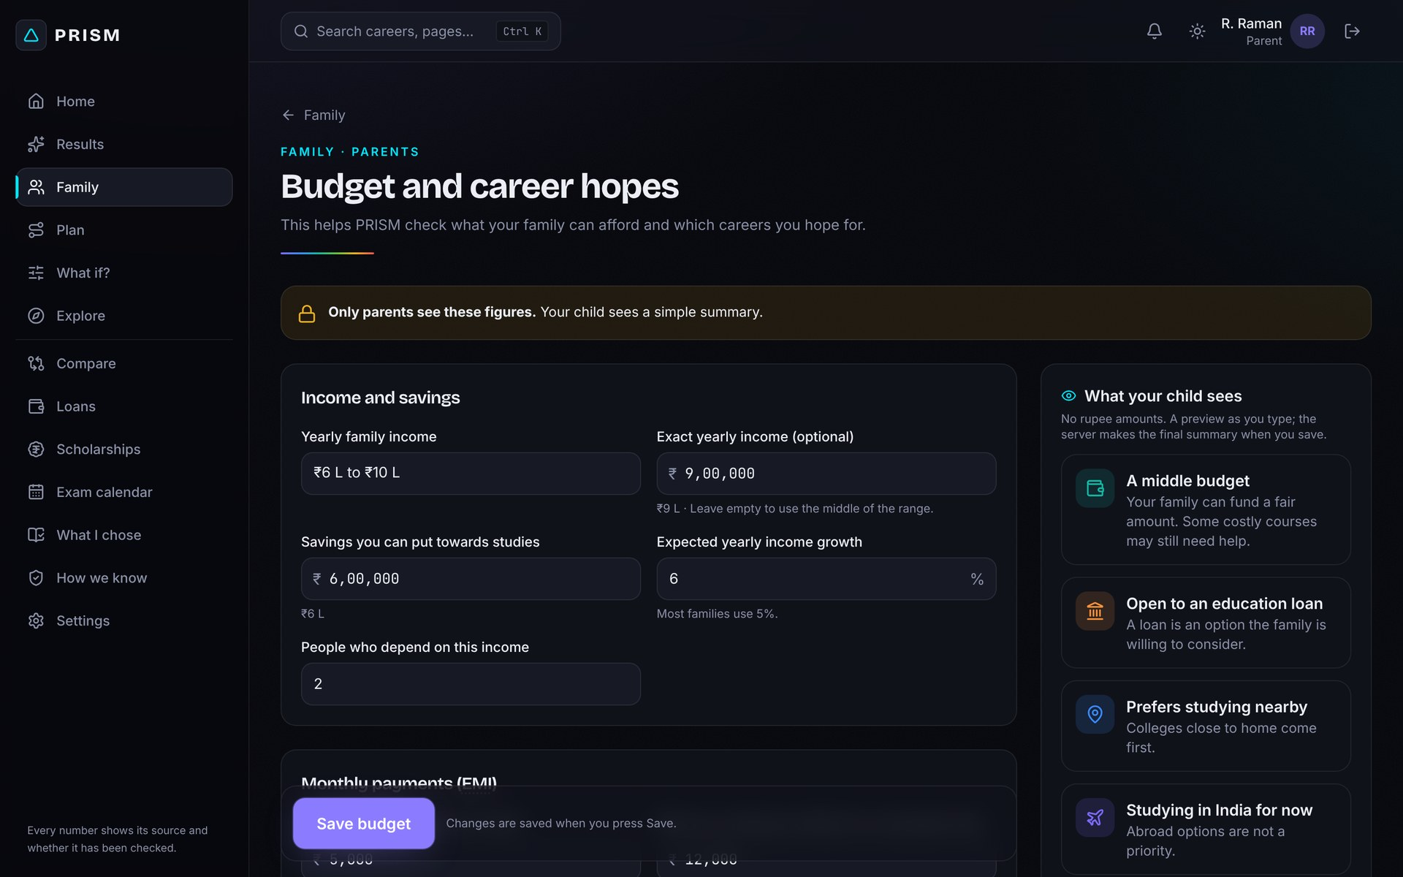
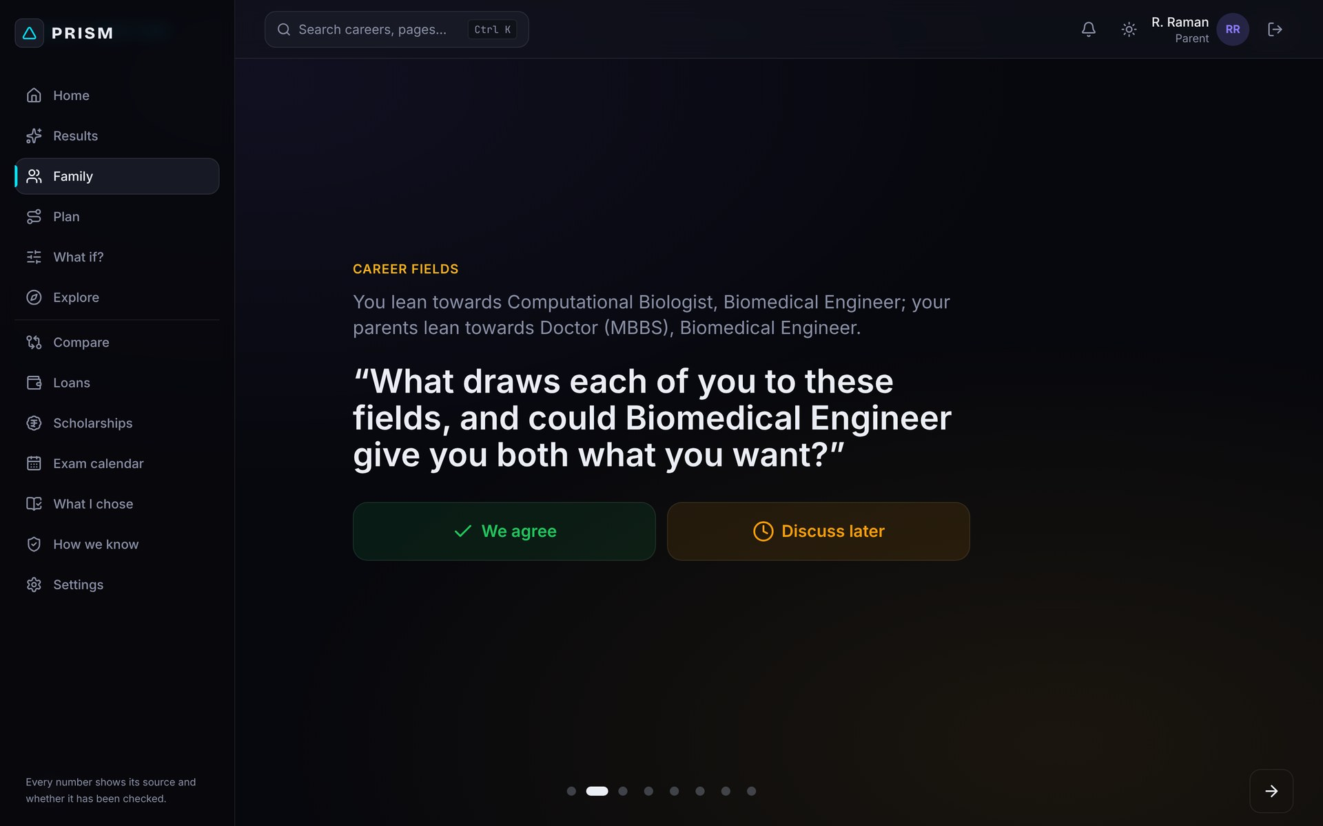
Parents see exactly where they and their child disagree
STEP 5 · THE FAMILY, BUILT IN
Private parent input
Joins with an invite code; budget and hopes stay private.
Conflict index
Field, risk, distance from home, budget, time to earn, prestige vs stability.
Guided family meeting
One question at a time, "We agree" or "Discuss later", plus bridge careers both sides accept.
PRISM · DataQuest 3.0 · 10
Notes:
This is our most distinctive feature: PRISM treats the family disagreement as data, not as noise. The parent joins with an invite code and enters the budget and their hopes privately. The conflict index measures where parent and child differ across six areas. Then a guided family meeting takes them through one question at a time, and suggests bridge careers that satisfy both sides.

Slide 11
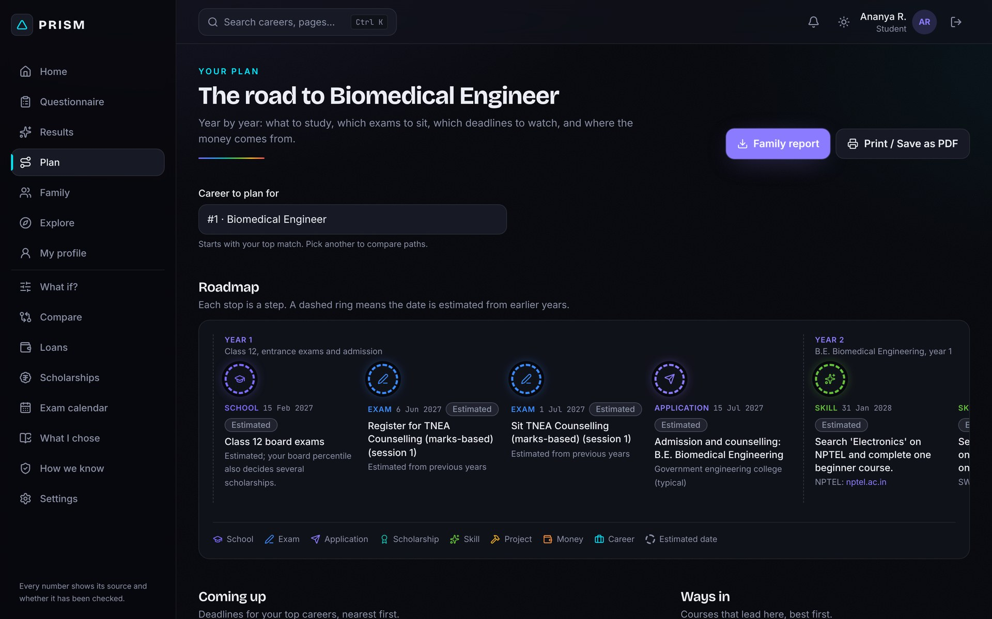
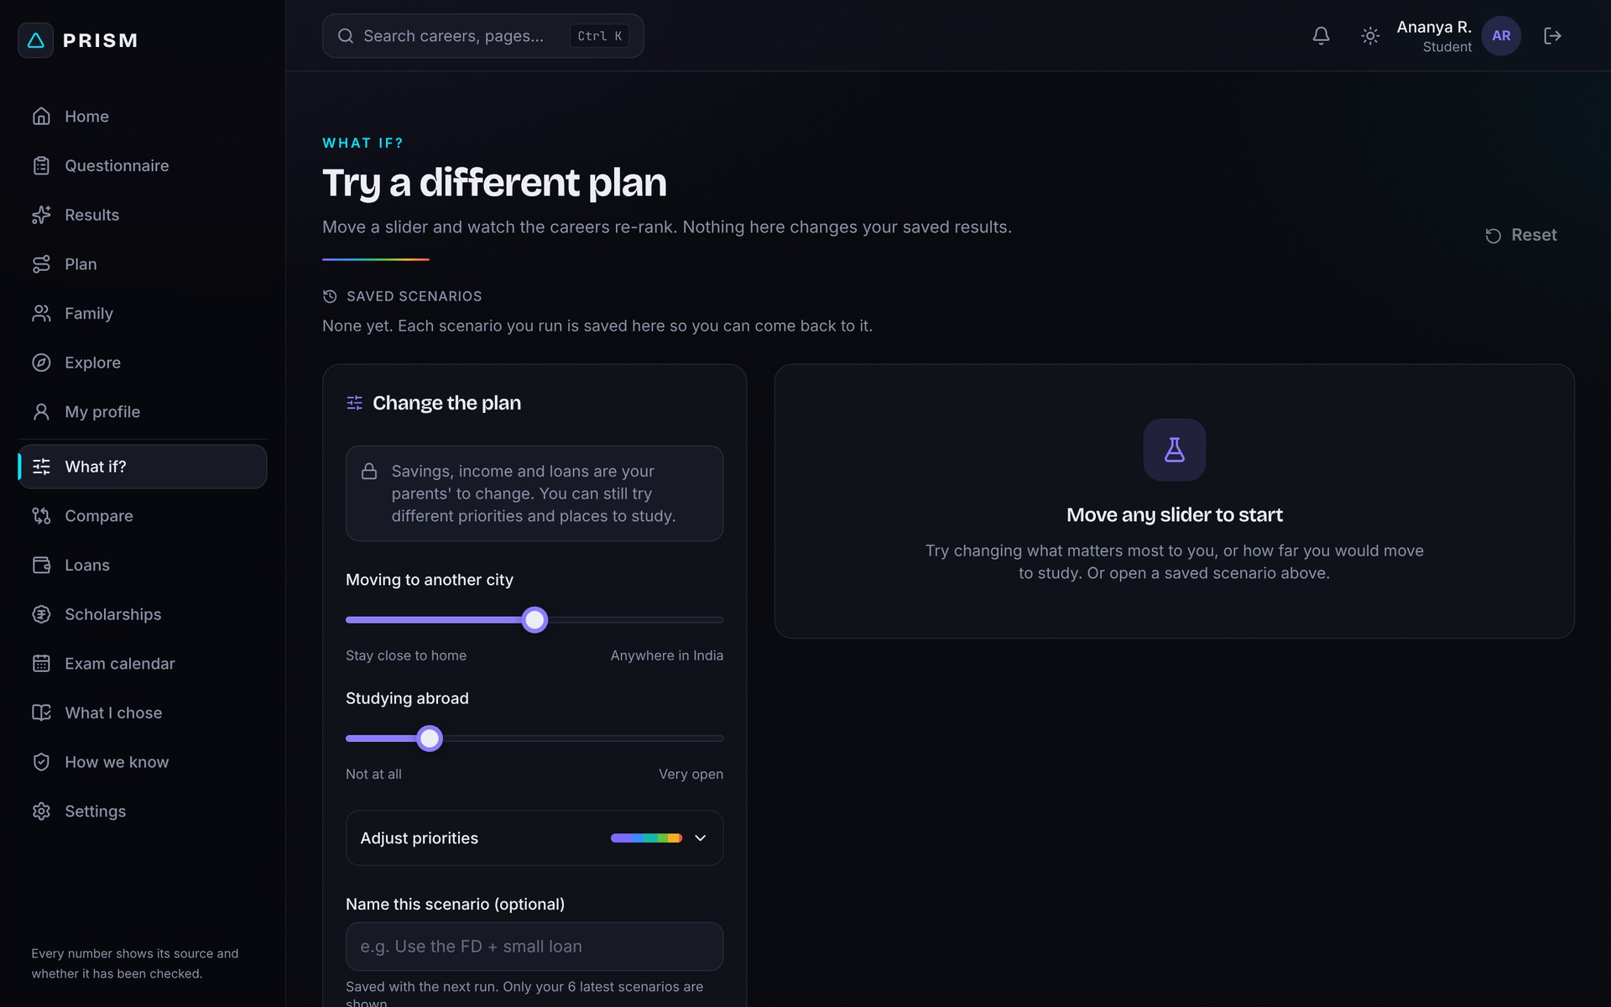
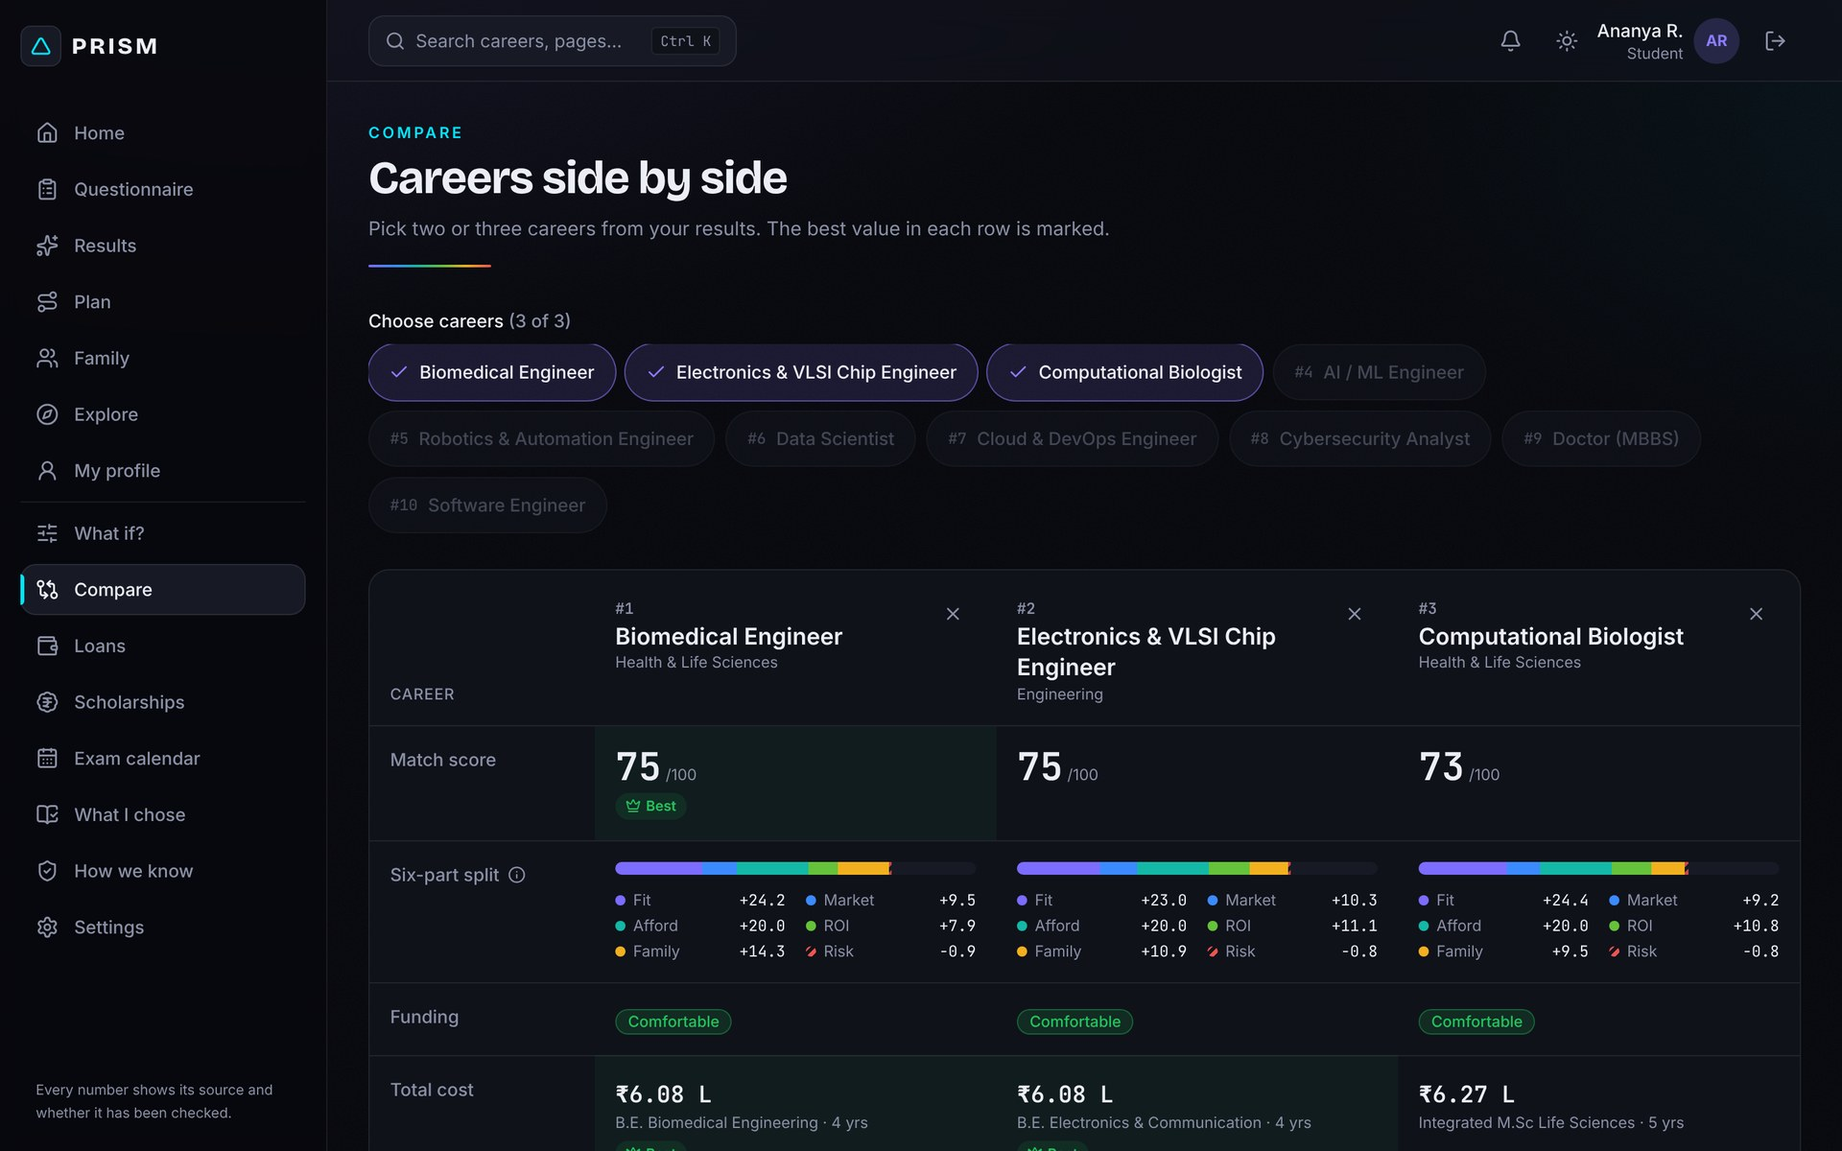
Change one thing and watch the list re-rank instantly
STEP 6 · EXPLORE AND DECIDE
What-if
More savings, a different city, different priorities: the ranking updates live.
Compare
Two or three careers side by side, part by part.
Plan
Entrance exams, deadlines and free courses (SWAYAM, NPTEL) on a 5-year roadmap.
PRISM · DataQuest 3.0 · 11
Notes:
Families can then explore. The what-if page lets them change savings, move to another city or reweight priorities, and the list re-ranks instantly. Compare puts two or three careers side by side. And the plan turns the choice into a five-year roadmap with entrance exams, deadlines and free courses from SWAYAM and NPTEL, which can be exported to a phone calendar.

Slide 12
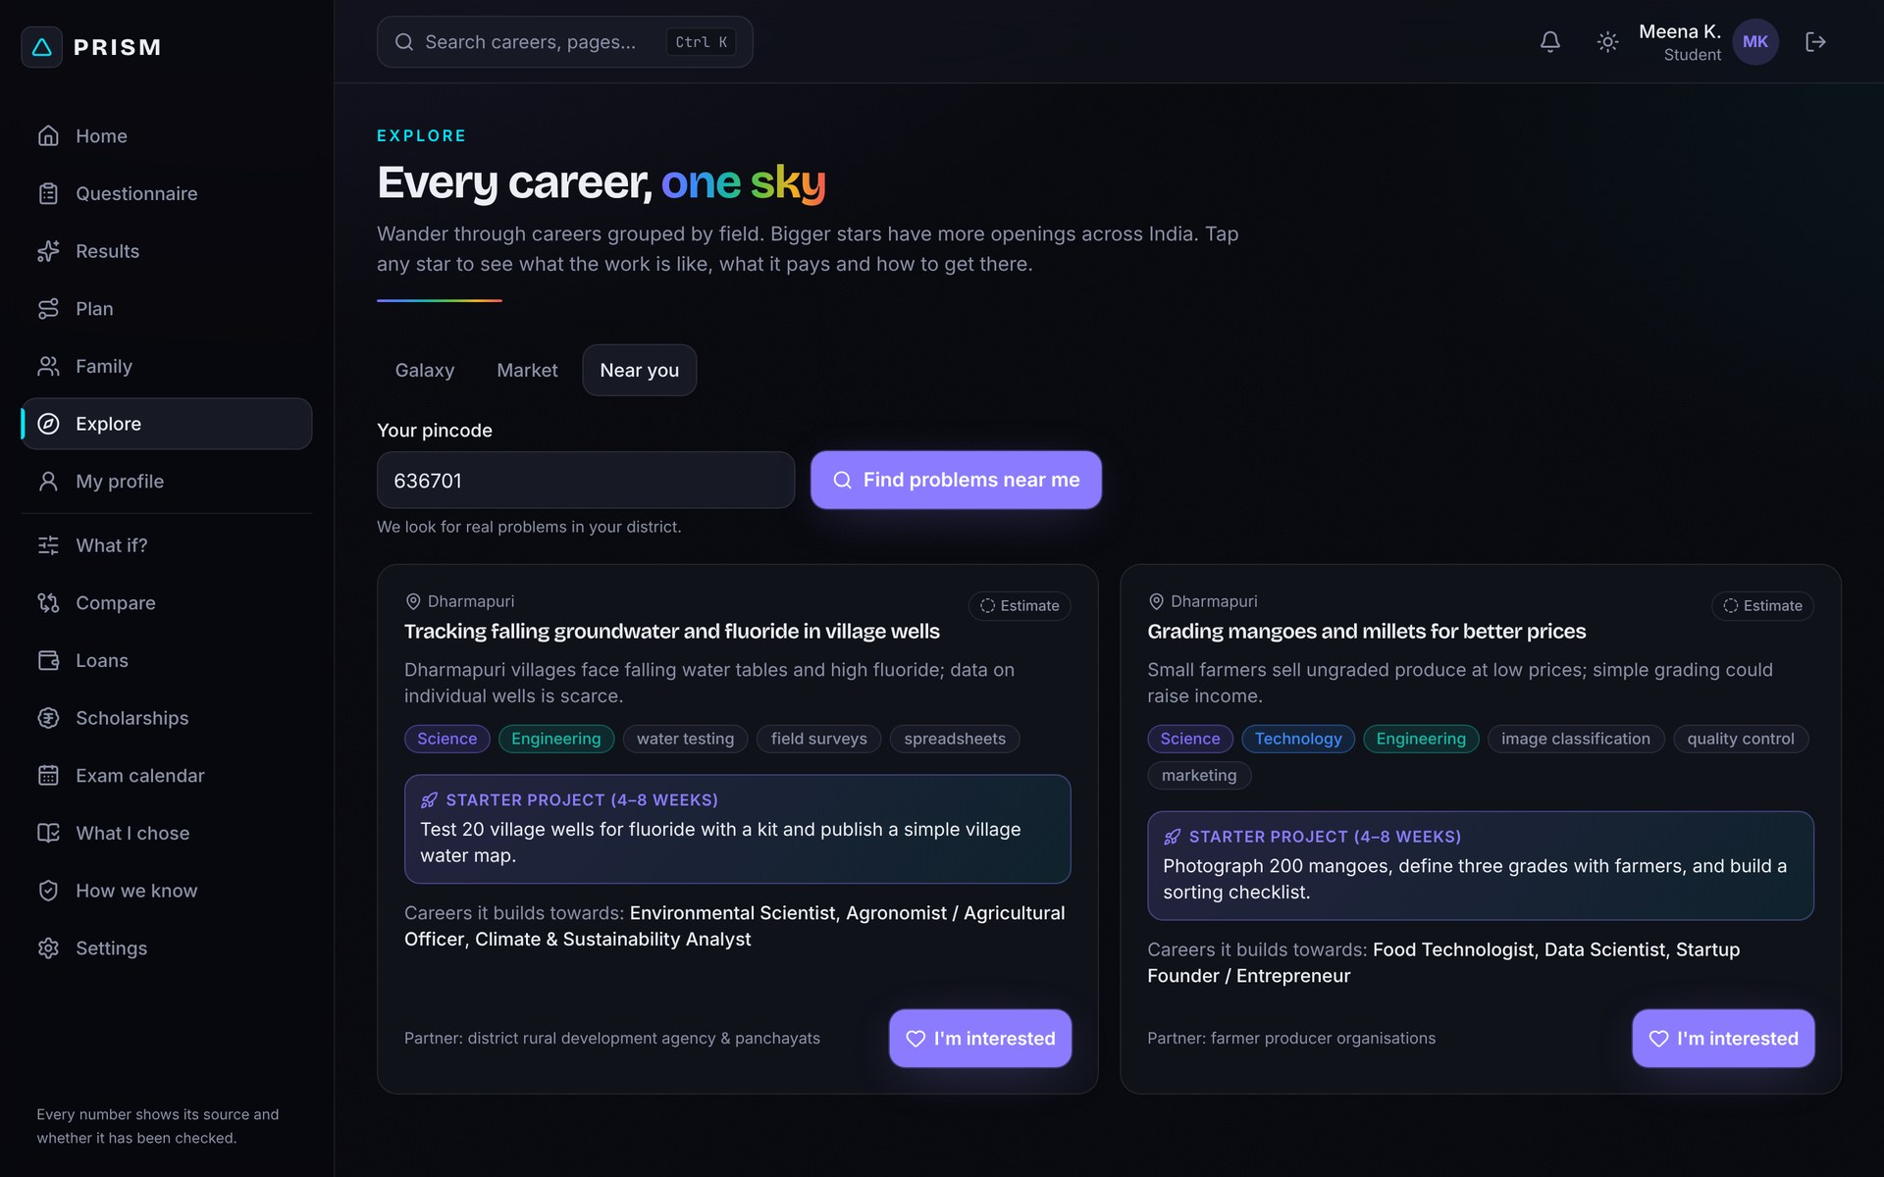
Real problems in the student's own district become starter projects
HYPER-LOCAL INNOVATION · THE SECOND HALF OF THE BRIEF
Enter a pincode
See real problems from your district, with the local partner behind each.
A 4–8 week starter project
Each problem comes with a first project and the careers it leads to.
Dharmapuri students test 20 village wells for fluoride and publish a water map.
PRISM · DataQuest 3.0 · 12
Notes:
This is the hyper-local half of the brief. A student enters their pincode and sees real problems from their own district, here Dharmapuri: fluoride in village wells, and grading mangoes and millets for better prices. Each problem has a four to eight week starter project, the local partner, and the careers it builds towards. It turns "STEAM careers" from an abstract list into something a rural student can start this month.

Slide 13
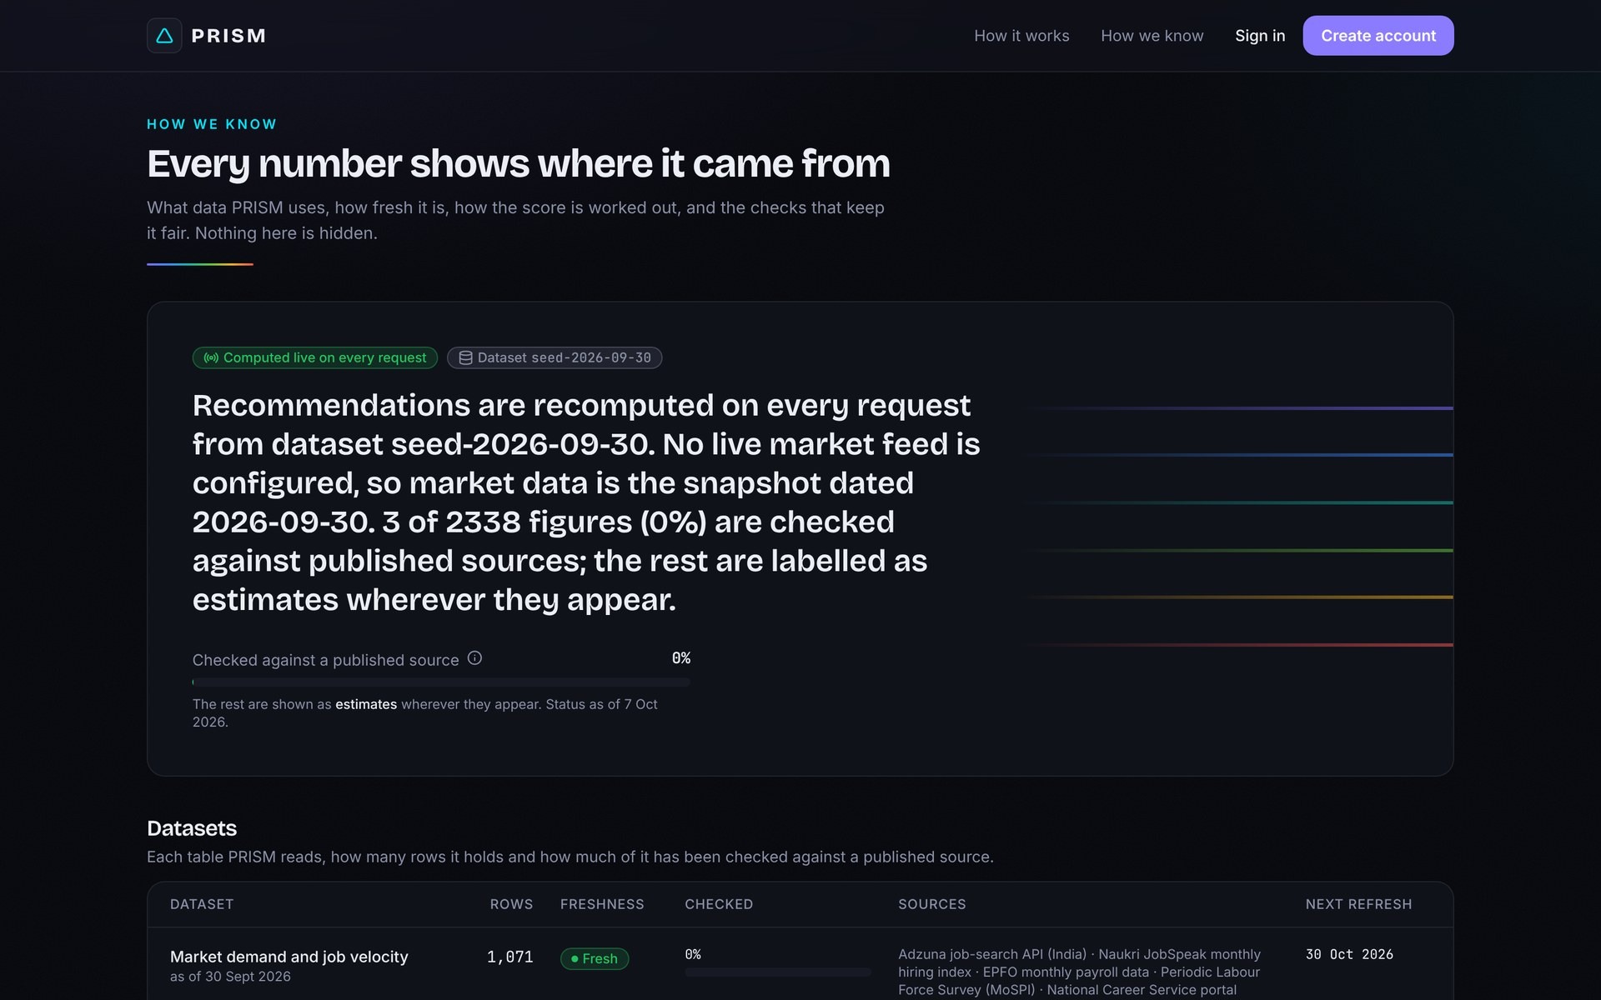
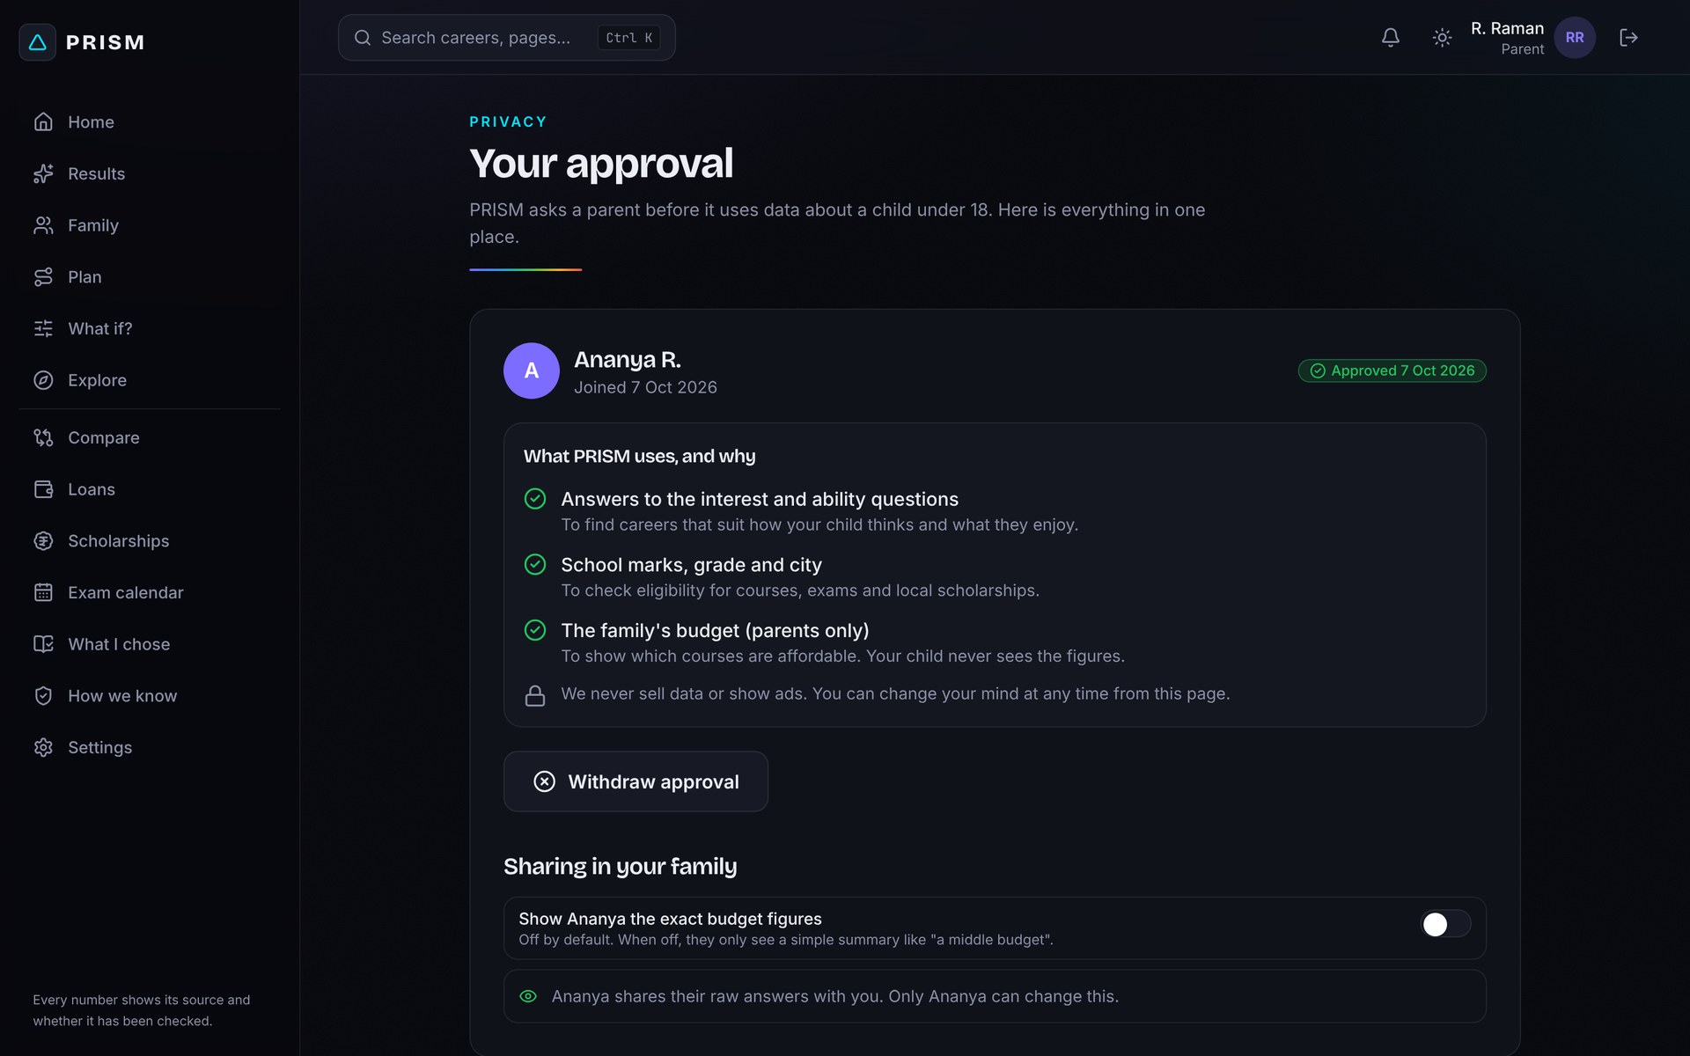
Every number shows its source, and whether it has been checked
TRUST, PRIVACY AND FAIRNESS
Honest data
Each figure is labelled Checked or Estimate. Rankings are reproducible from stored data versions.
AI that cannot invent
The AI only rephrases summaries, never scores; an answer with a made-up number is rejected.
Privacy and fairness
Parental consent under 18, family money private, no caste data collected, automated fairness checks.
PRISM · DataQuest 3.0 · 13
Notes:
Guidance is only useful if families can trust it. Every figure in PRISM shows its source and whether it was checked or is an estimate, and the "How we know" page lists every dataset. Rankings are deterministic and reproducible. The AI only rephrases the summary; it never scores, and any answer containing a number that is not in the facts is rejected. Under-18s need parental approval, family money stays private, and we never collect caste or category.

Slide 14
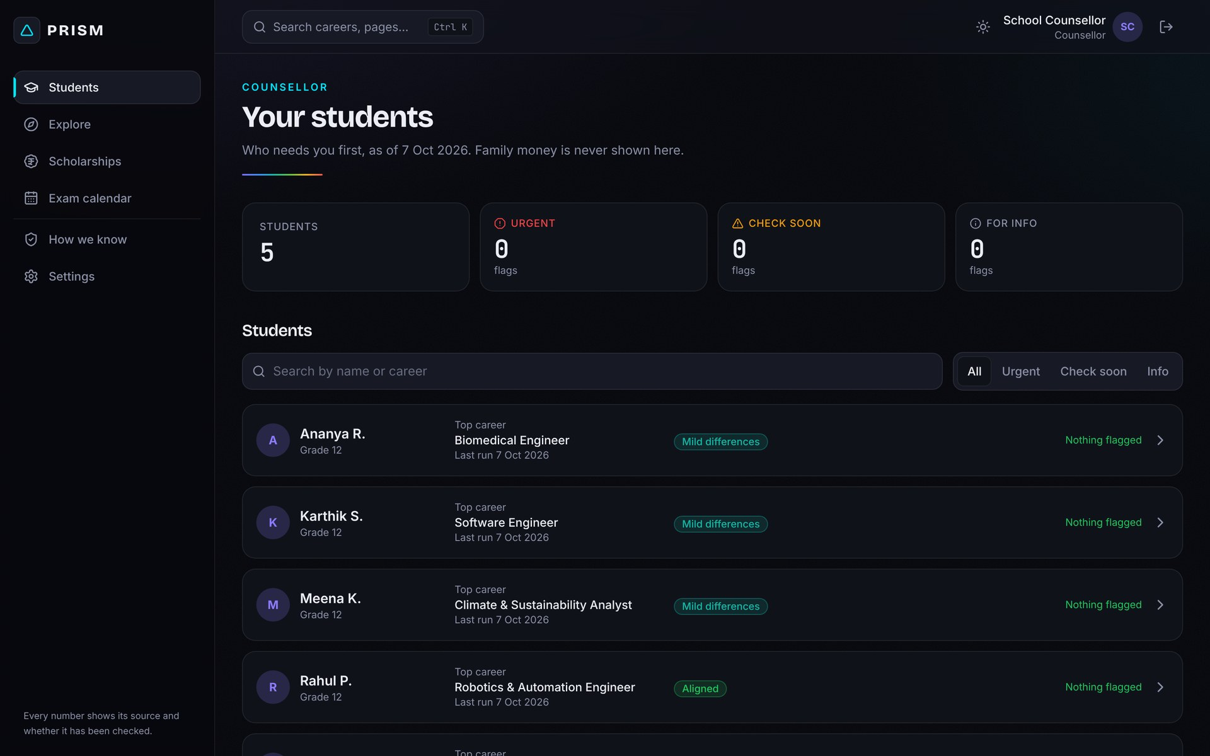
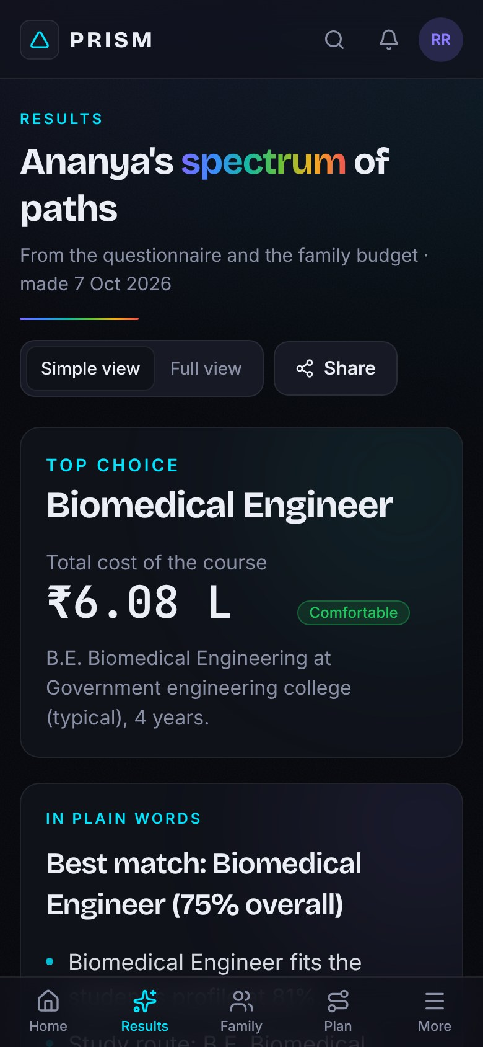
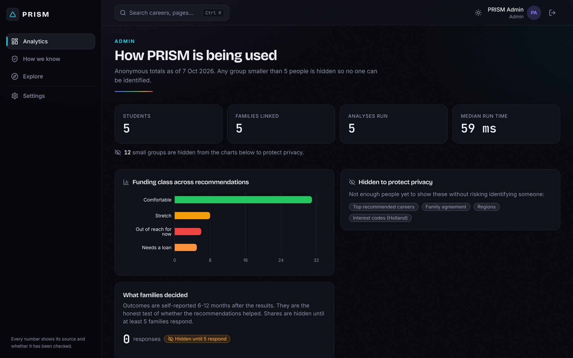
One counsellor, hundreds of students, attention where it is needed
BUILT FOR SCHOOLS TO USE AT SCALE
Counsellor dashboard
Flags high family conflict, loan dependence and missed steps. Family money is never shown.
Anonymised analytics
School-wide trends, with small groups hidden to protect privacy.
Phone first
Works on low-end phones and slow connections.
PRISM · DataQuest 3.0 · 14
Notes:
PRISM is built for schools. A counsellor sees all their students on one dashboard, with flags for the ones who need a human conversation: high family conflict, dependence on a loan, or missed steps. Family money is never shown to them. Admins get anonymised analytics where small groups are hidden. And the whole app works on a phone, which is how most of our users will open it.

Slide 15
A working, tested product, not a mock-up
UNDER THE HOOD
React app
FastAPI service
Scoring engine + database
Vercel · TypeScript, Tailwind
Render · JWT sign-in, roles
Pure functions · PostgreSQL
+ Live job-postings feed (Adzuna), with offline import
+ Optional AI summary writer, fact-checked
51
101
41
42
33
20
120
careers
study pathways
institutions
scholarships
entrance exams
local problems
automated tests
React · TypeScript · Tailwind · FastAPI · SQLAlchemy · PostgreSQL · JWT
PRISM · DataQuest 3.0 · 15
Notes:
Under the hood this is a real, deployed product. A React app on Vercel talks to a FastAPI service on Render, which runs a scoring engine written as pure, fully tested functions over a PostgreSQL database. A live job-postings feed and an optional AI summary writer plug in at the side. The catalogue holds 51 careers, 101 study pathways, 41 institutions, 42 scholarships, 33 entrance exams and 20 local problems, and 120 automated tests cover the engine, fairness and data quality.

Slide 16
From a ranking on a screen to a decision a family makes together
IMPACT AND NEXT STEPS
Impact
Next
Students choose with evidence, not hearsay
Parents are heard, and see the real cost
Counsellors spend time where it is needed
Rural students find STEAM work near home
Pilot the questionnaire with real schools
SMS and WhatsApp deadline reminders
Atal Tinkering Lab partners for local problems
6–12 month outcome follow-up
See every path. Choose yours together.
Try it: dataquest-frontend-theta.vercel.app
PRISM · DataQuest 3.0 · 16
Notes:
PRISM turns a ranking on a screen into a decision a family makes together. Students choose with evidence, parents are heard and see the real cost, counsellors spend their time where it matters, and rural students find STEAM work near home. Next we want to pilot the questionnaire in real schools, switch on SMS and WhatsApp reminders, partner with Atal Tinkering Labs for more local problems, and follow up on outcomes after six to twelve months. Thank you; the live demo is at dataquest-frontend-theta.vercel.app, and all demo logins are in our README.

